Slide 1
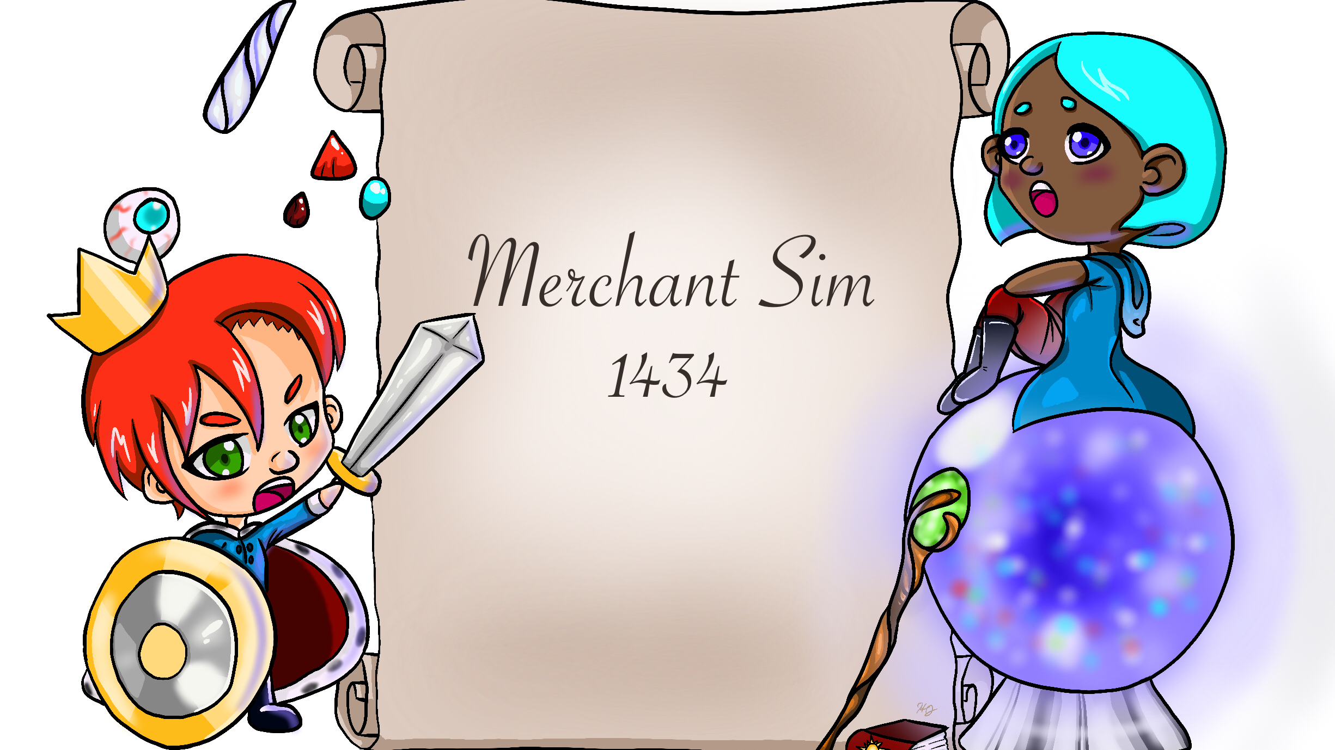
Custom Photo Placeholder
Computer Pub
Andrew Banks
Joshua Byers
Holland Johnson
Austin Rhodes
Dylan Sullenberger

Slide 2
Introduction
Web based clicker game based on the stock market.
Fantasy theme to keep things fun and interesting.
Event and Royalty systems used to spice up gameplay and add element of randomness.
We thought it would be interesting to make a simple web-based game since none of us have experience doing so.
We were able to complete our basic goals but did not have time to add additional features.

Slide 3
Customer Value
Our product provides a casual gaming experience for audiences of any age.
Players can try to play the odds by keeping track of events and paying attention to shifts in the monarchy or can simply buy stocks and let the game run in the background.
More systems such as controlling the game time and less intrusive popups may be added later to further market towards a casual audience.

Slide 4
Technology
Product runs an HTML webpage and uses Javascript and Jquery for the actual game.
Functions like a dynamically shifting website.
Timer runs in the background the controls the shift of stock prices and other aspects.

Slide 5
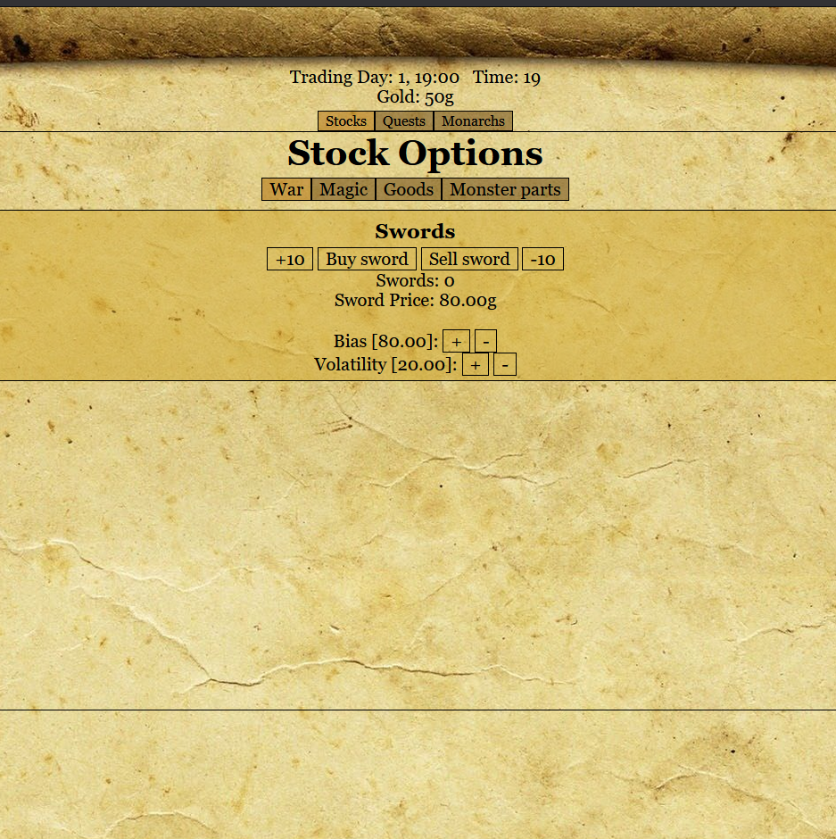
Tech-Stocks and Quests
Stocks are broken into categories.
Bias system keeps price level
Volatility system controls price shifts
Quests offer alternative ways to make money and manipulate stocks

Slide 6
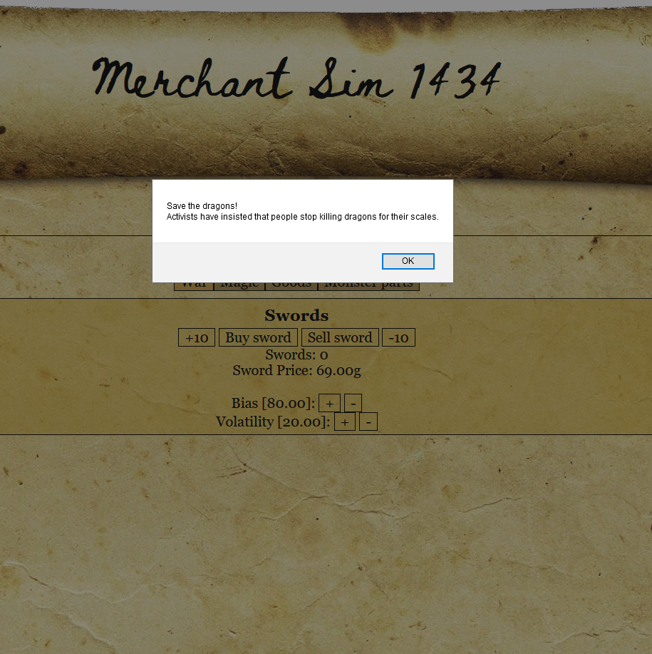
Tech-Event System
As time passes, dynamic events will occur that fit into the fantasy game world.
Events shift the bias and volatility of various stocks when they occur.
The shift in volatility is temporary to replicate real life stock movement, but the change in bias is permanent.

Slide 7
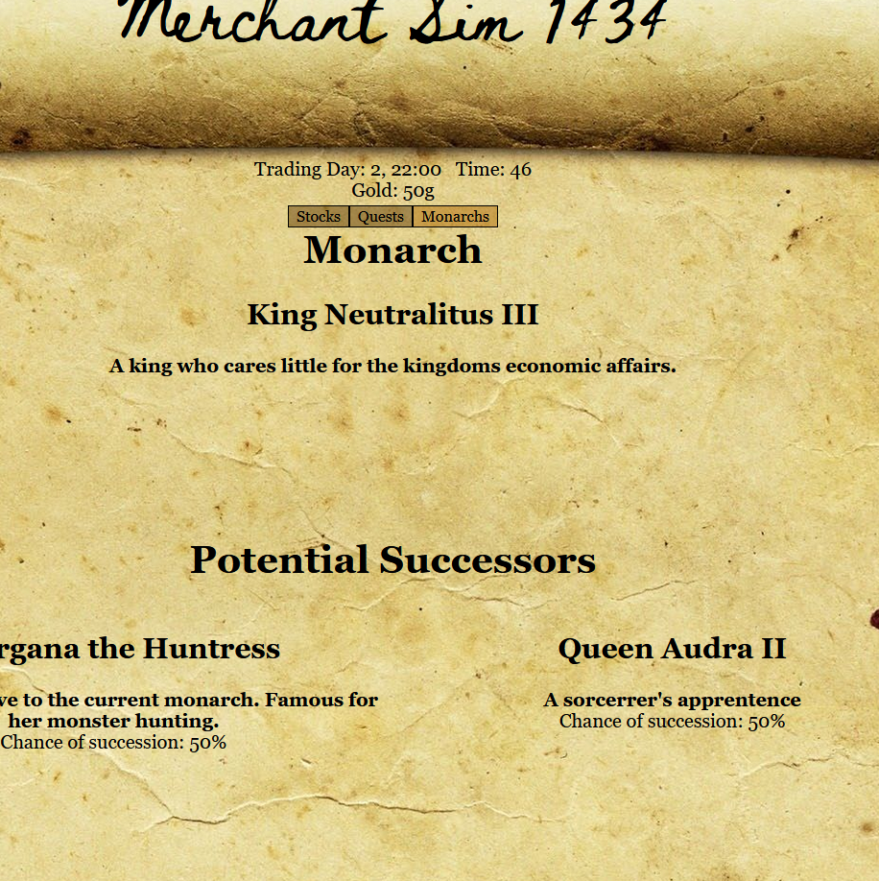
Tech-Monarch System
The fictional kingdom where the game is set is always ruled by a monarch.
Every monarch has special interests that affect entire categories of stocks.
After a while, the current monarch will be replaced with a new one.
The player can view the possible successors and see the percentage of them becoming the next monarch.

Slide 8
Team
Andrew Banks – Software developer (Focused on Event and Monarch systems).
Austin Rhodes – Software developer (Focused on Stock and Quest systems)
Joshua Byers – Software developer (CSS and Layout)
Holland Johnson – Art director
Dylan Sullenberger – Assisted in various aspects of software development. Writer.

Slide 9
Project Management
The team met every Tuesday and Thursday to discuss what needed to be completed for the week.
The team also constantly communicated through Discord to ask questions and share ideas and ask for help

Slide 10
Project Management
All the basic goals for the project were met. (Stock trading, quests, events, monarchs).
There were various other features the team was hoping to add if there was extra time.
Starting a guild for quests that could be leveled up, ability to become the monarch, magical items that can manipulate the market.
There were also some basic concepts that we did not think of until late into the project that were not completed. (Save systems, Stock portfolio).

Slide 11
Project Management
Time was lost due to unfamiliarity with Javascript
Unfamiliarity with interpreter languages.
Unfamiliarity with a dynamically changing website.
And issues with combining changes to code across multiple team members.

Slide 12
Reflection
The project went well, but more could have been done to make a more fleshed out game.
We may have underestimated our unfamiliarity with the systems that we were using.
The team worked well together; communication was easy.
Development was the cause of most our problems.

Slide 13
Demo

